Slide 1

It’s not a bug,
it’s a feature!
Erik Hellman, Spotify
Twitter: @ErikHellman
Google+: google.com/+ErikHellman
Facebook: facebook.com/ErikHellman Github: github.com/ErikHellman

Slide 2

wiley.com/go/ptl/androidprogramming

Slide 3
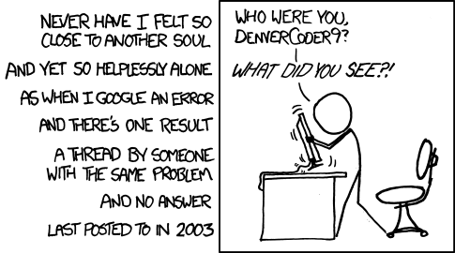
http://xkcd.com/979/

Slide 4

WARM UP!

Slide 5
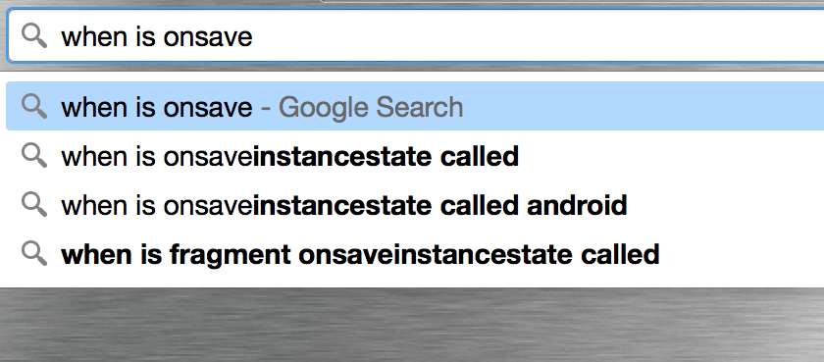
Activity.onSaveInstanceState()

Slide 6
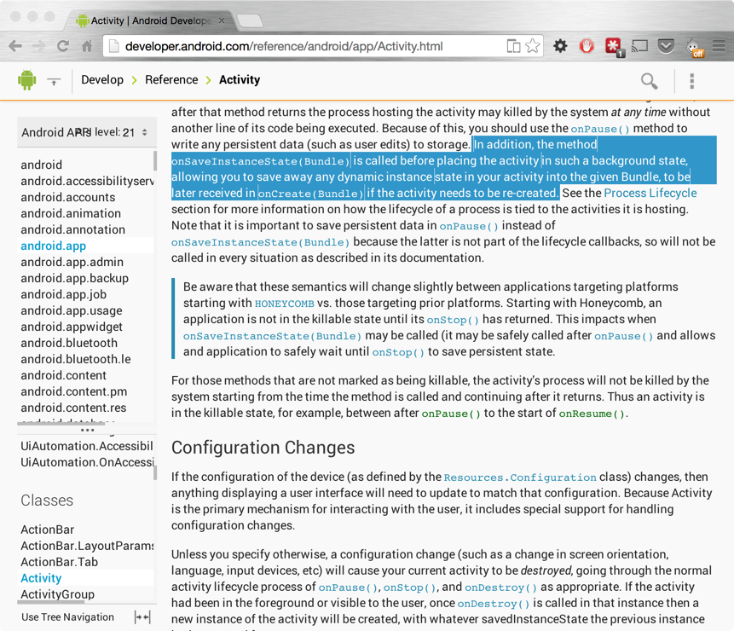
Activity.onSaveInstanceState()

Slide 7
Activity.onSaveInstanceState()
Pressing Home
Calling finish()
Pressing back
Rotating device
Starting new Activity

Slide 8
Activity.onSaveInstanceState()
Pressing Home
Calling finish()
Pressing back
Rotating device
Starting new Activity
✓
✗
✗
✓
✓

Slide 9
Activity.onSaveInstanceState()
Lesson learned:
Don’t use onSaveInstanceState() for anything but View related stuff!

Slide 10
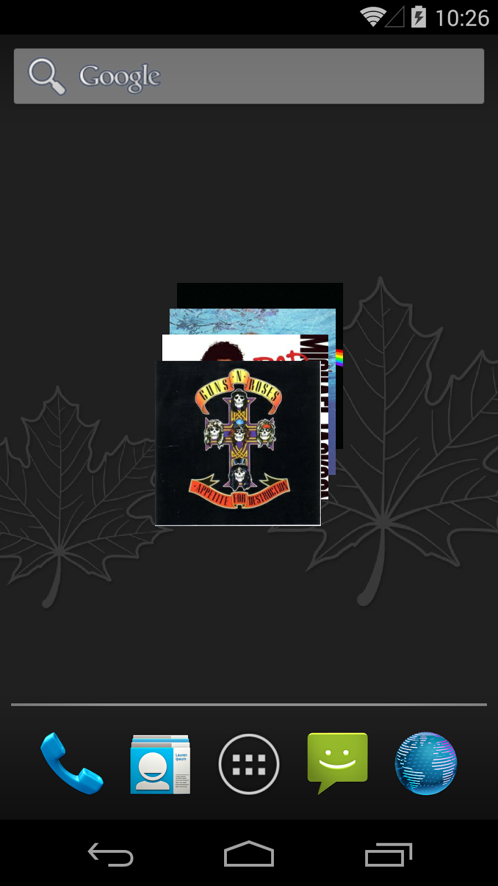
App Widgets

Slide 11
App Widgets
public RemoteViews getViewAt(int position) {
RemoteViews rv = new RemoteViews(mContext.getPackageName(),
R.layout.photo_item);
rv.setImageViewBitmap(R.id.widget_item, mAlbums[position]);
...
}

Slide 12
App Widgets + ContentProvider
ContentProvider

Slide 13
App Widgets + ContentProvider
public RemoteViews getViewAt(int position) {
RemoteViews rv = new RemoteViews(mContext.getPackageName(),
R.layout.photo_item);
Uri albumUri = Uri.parse(ALBUM_BASE_URI + position);
ContentResolver contentResolver =
mContext.getContentResolver();
InputStream inputStream =
contentResolver.openInputStream(albumUri);
Bitmap albumPhoto = BitmapFactory.decodeStream(inputStream);
rv.setImageViewBitmap(R.id.widget_item, albumPhoto);
...
}

Slide 14
App Widgets + ContentProvider
public class MyImageProvider extends ContentProvider {
...
@Override
public ParcelFileDescriptor openFile(Uri uri, String mode)
throws FileNotFoundException {
File albumPhoto = new File(mAlbumDir,
"album-" + uri.getLastPathSegment() + ".jpg");
return ParcelFileDescriptor.open(albumPhoto,
ParcelFileDescriptor.MODE_READ_ONLY);
}
}

Slide 15
App Widgets + ContentProvider
10-29 10:41:48.688 1235-1247/se.hellsoft.appwidgetwithcollections E/AndroidRuntime﹕ FATAL EXCEPTION: Binder_2
Process: se.hellsoft.appwidgetwithcollections, PID: 1235
java.lang.SecurityException: Permission Denial: reading com.example.android.stackwidget.MyImageProvider uri content://com.example.android.stackwidget.photo/albumPhoto/0 from pid=677, uid=10008 requires the provider be exported, or grantUriPermission()

Slide 16
App Widgets + ContentProvider
public RemoteViews getViewAt(int position) {
RemoteViews rv = new RemoteViews(mContext.getPackageName(),
R.layout.photo_item);
Uri albumUri = Uri.parse(ALBUM_BASE_URI + position);
long oldIdentity = Binder.clearCallingIdentity();
ContentResolver contentResolver =
mContext.getContentResolver();
InputStream inputStream =
contentResolver.openInputStream(albumUri);
albumPhoto = BitmapFactory.decodeStream(inputStream);
Binder.restoreCallingIdentity(oldIdentity);
rv.setImageViewBitmap(R.id.widget_item, albumPhoto);
...
}

Slide 17
Lesson learned:
Understand what calling identity is and how the Binder calls work.

Slide 18
When is the first time your BroadcastReceiver can be called?

Slide 19
Cheap auto-start without permission? ;)
<receiver android:name="se.hellsoft.badreceiver.MyReciever"
android:enabled="true"
android:exported="true">
<intent-filter>
<action android:name="android.intent.action.USER_PRESENT" />
</intent-filter>
</receiver>

Slide 20
Cheap auto-start without permission? ;)
@Override
public void onReceive(Context context, Intent intent) {
Toast.makeText(context,
"Received broadcast: " + intent.getAction(),
Toast.LENGTH_SHORT).show();
Intent activity = new Intent(context, MyActivity.class);
activity.setFlags(Intent.FLAG_ACTIVITY_NEW_TASK);
context.startActivity(activity);
}

Slide 21
Lesson learned:
App must have been started once before a registered receiver will be triggered (for certain Intents)!

Slide 22
Bound Service
How does Service.onBind() work?

Slide 23
Service.onBind()
“Multiple clients can connect to the service at once. However, the system calls your service's onBind() method to retrieve the IBinder only when the first client binds. The system then delivers the same IBinder to any additional clients that bind, without calling onBind() again.”

Slide 24
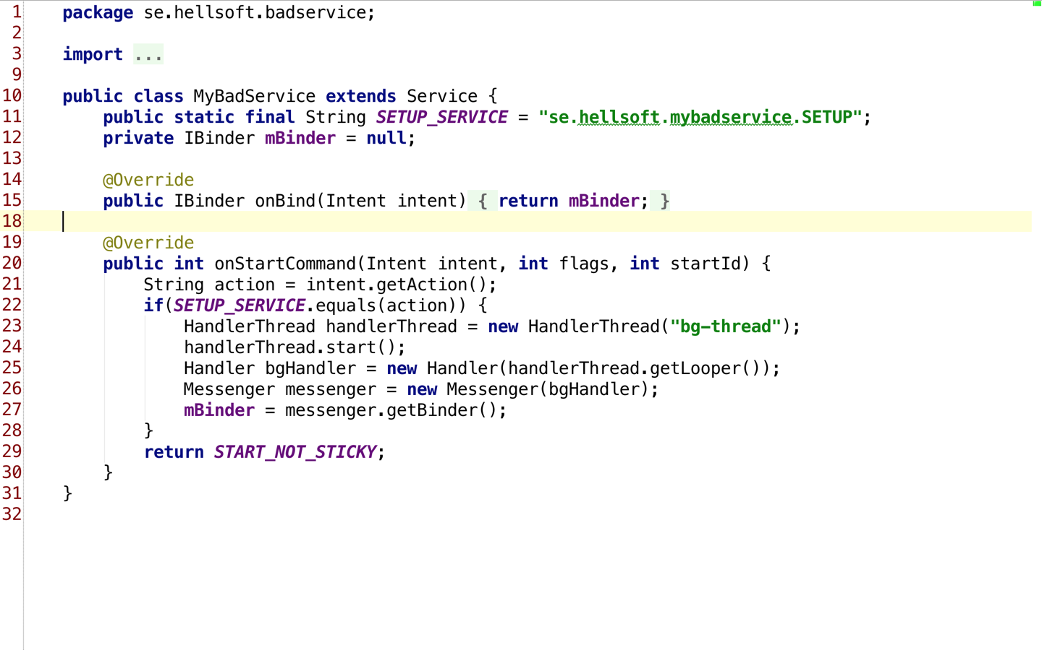
Service.onBind()

Slide 25
Service.onBind()
Lesson learned 1:
The Binder object is cached by the system, based on the Intent used for binding.
Always create the Binder object at Service initialisation!

Slide 26
Service.onBind()
Lesson learned 2:
An Intent for binding is unique based on action string and data URI.
You can pass parameter to onBind() using the data URI of the Intent! :)

Slide 27
ServiceConnection
@Override
public void onServiceConnected(ComponentName componentName,
IBinder iBinder) {
// Called when binding is complete
mService = IMyAidlInterface.Stub.asInterface(iBinder);
}
@Override
public void onServiceDisconnected(ComponentName componentName) {
// Called when?
mService = null;
}

Slide 28
ServiceConnection
@Override
protected void onStart() {
super.onStart();
bindService(new Intent(this, MyService.class),
this, BIND_AUTO_CREATE);
}
@Override
protected void onStop() {
unbindService(this);
super.onStop();
}

Slide 29
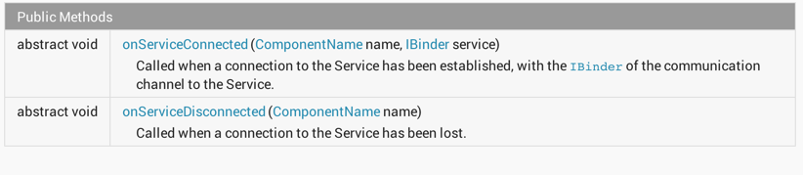
ServiceConnection

Slide 30
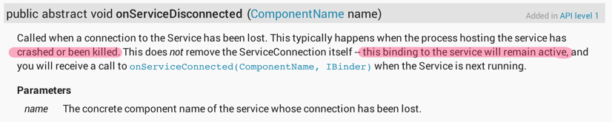
ServiceConnection

Slide 31
ServiceConnection
@Override
protected void onStart() {
super.onStart();
bindService(new Intent(this, MyService.class), this,
BIND_AUTO_CREATE);
}
@Override
protected void onStop() {
mService = null;
unbindService(this);
super.onStop();
}

Slide 32
ServiceConnection
Lesson learned:
Read the JavaDoc properly.
Again. :)

Slide 33
The Application Termination Bug
I/ActivityManager﹕ Killing 1433:se.hellsoft.demo/u0a61 (adj 0): remove task

Slide 34
The Application Termination Bug
Start Activity
Start Service in foreground
Leave Activity
Remove task
App receives a broadcast
Process killed!

Slide 35
The Application Termination Bug
Lesson learned:
Shut down your services in onTaskRemoved()
@Override
public void onTaskRemoved(Intent rootIntent) {
super.onTaskRemoved(rootIntent);
stopForegroundJob();
}
Read more at: http://www.doubleencore.com/2014/06/effects-android-application-termination/

Slide 36
createWindowSurface failed EGL_BAD_ALLOC
java.lang.RuntimeException: createWindowSurface failed EGL_BAD_ALLOC
at android.view.HardwareRenderer$GlRenderer.createSurface(HardwareRenderer.java:763)
at android.view.HardwareRenderer$GlRenderer.createEglSurface(HardwareRenderer.java:663)
at android.view.HardwareRenderer$GlRenderer.initialize(HardwareRenderer.java:502)
at android.view.ViewRootImpl.performTraversals(ViewRootImpl.java:1325)
at android.view.ViewRootImpl.handleMessage(ViewRootImpl.java:2467)
at android.os.Handler.dispatchMessage(Handler.java:99)
at android.os.Looper.loop(Looper.java:137)
at android.app.ActivityThread.main(ActivityThread.java:4424)
at java.lang.reflect.Method.invokeNative(Native Method)
at java.lang.reflect.Method.invoke(Method.java:511)
at com.android.internal.os.ZygoteInit$MethodAndArgsCaller.run(ZygoteInit.java:784)
at com.android.internal.os.ZygoteInit.main(ZygoteInit.java:551)
at dalvik.system.NativeStart.main(Native Method)

Slide 37
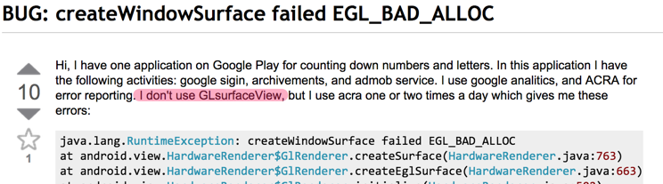
createWindowSurface failed EGL_BAD_ALLOC

Slide 38

createWindowSurface failed EGL_BAD_ALLOC

Slide 39
createWindowSurface failed EGL_BAD_ALLOC
Lesson learned:
Use fewer and/or smaller bitmaps if possible!
Can also happen if you leak a reference to a Surface!

Slide 40
UnsatisfiedLinkError
Why isn’t my .so file loaded?!? E/AndroidRuntime( 999): Caused by: java.lang.UnsatisfiedLinkError: Couldn't load my-native-lib from loader dalvik.system.PathClassLoader[DexPathList[dexElements=[zip file "/data/app/se.hellsoft.appwithnativelib-2.apk"],nativeLibraryDirectories=[/vendor/lib, /system/lib]]]: findLibrary returned null

Slide 41
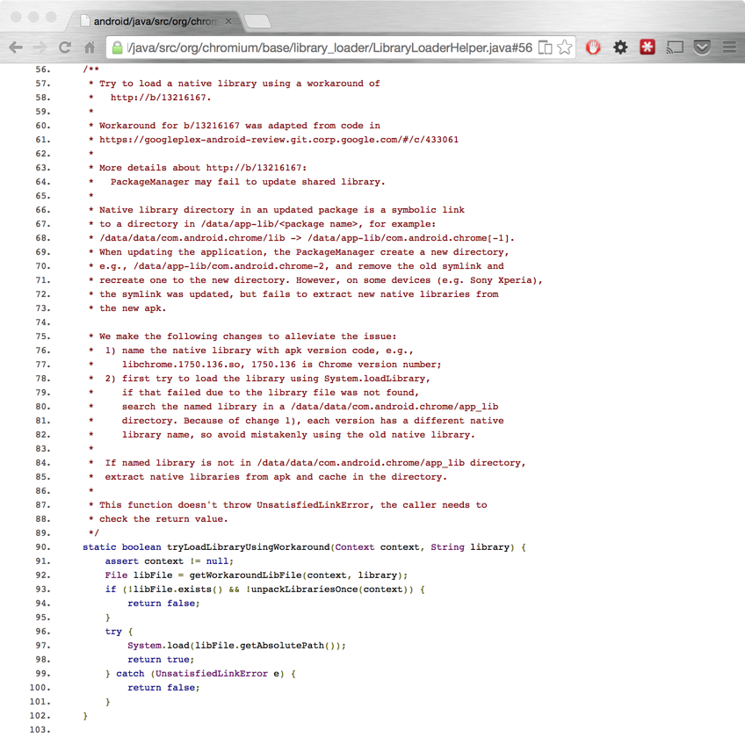
UnsatisfiedLinkError

Slide 42
UnsatisfiedLinkError
Lesson learned:
Steal Copy the fallback loader (LibraryLoaderHelper.java) from the Chromium project!
Source: http://goo.gl/9XRCSK

Slide 43
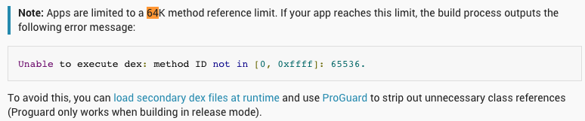
64k method limit
“64k should be enough for anyone!”

Slide 44
64k method limit
$ ~/android-sdk-macosx/build-tools/21.0.1/dx --help
usage:
dx --dex [--debug] [--verbose] [--positions=<style>] [--no-locals]
[--no-optimize] [--statistics] [--[no-]optimize-list=<file>] [--no-strict]
[--keep-classes] [--output=<file>] [--dump-to=<file>] [--dump-width=<n>]
[--dump-method=<name>[*]] [--verbose-dump] [--no-files] [--core-library]
[--num-threads=<n>] [--incremental] [--force-jumbo]
[--multi-dex [--main-dex-list=<file> [--minimal-main-dex]]
...

Slide 45
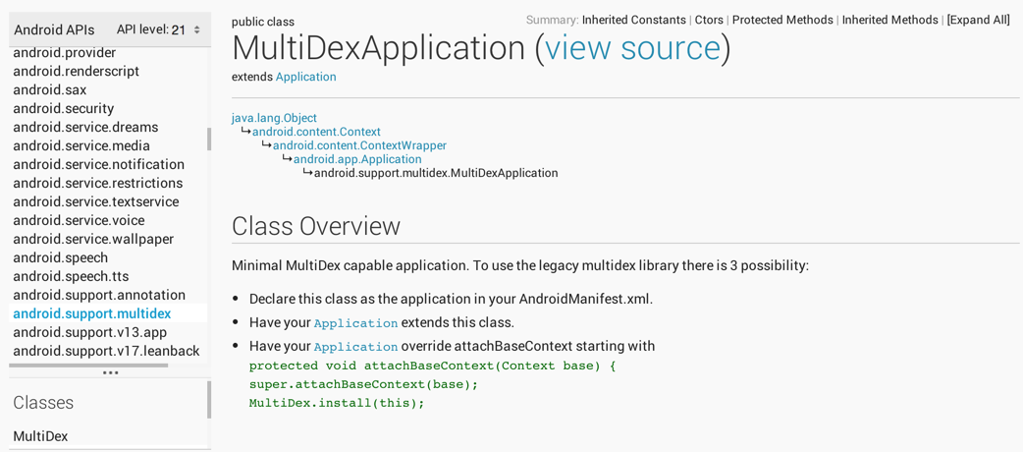
64k method limit

Slide 46
64k method limit
Temporary build hack (Better solution coming n future build tools):
android {
....
dexOptions {
preDexLibraries = false
}
}
afterEvaluate {
tasks.matching {
it.name.startsWith('dex')
}.each { dx ->
if (dx.additionalParameters == null) {
dx.additionalParameters = []
}
dx.additionalParameters += '--multi-dex'
dx.additionalParameters += "--main-dex-list=$projectDir/multidex.keep".toString()
}
}

Slide 47
64k method limit
Lesson learned:
Use ProGuard!
Avoid really huge libraries (Hello Guava!)
Only use multi-dex as a last resort…

Slide 48
Conclusions...
Android documentation can be vague
Google engineers are just like you and me!
Check the (AOSP) source to understand what the platform does (http://androidxref.com)
Submit bug reports and patches! :-)
Code samples available at github.com/ErikHellman/FeatureNotABug

Slide 49
Thank you for listening!
Any questions? :)

